Slide 1
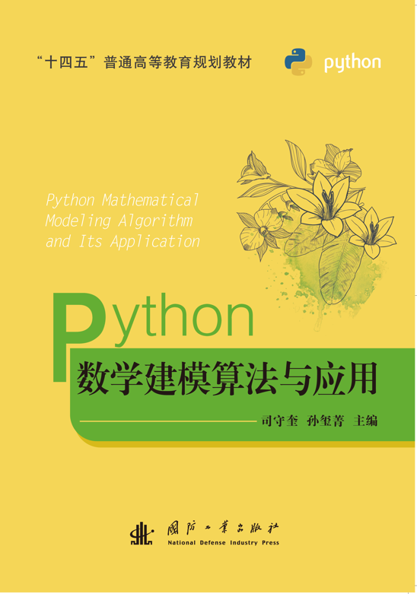
第11章
聚类分析与判别分析

Slide 2
目录
11.1 聚类分析
11.2 判别分析

Slide 7
11.1
聚类分析

Slide 8
11.1.1 数据变换

Slide 9
1.中心化处理

Slide 10
2.规格化变换

Slide 11
3.标准化变换

Slide 13
11.1.2 样本（或指标）间亲疏程度的测度计算

Slide 15
1.常用距离的计算

Slide 18
2.相似系数的计算

Slide 22
11.1.3 scipy.cluster.hierarchy模块的系统聚类

Slide 23
1. linkage

Slide 27
2. fcluster

Slide 28
3. H＝dendrogram(Z, p)

Slide 29
11.1.4 基于类间距离的系统聚类

Slide 33
1.最短距离法

Slide 42
#程序文件ex11_1_1.py
import scipy.cluster.hierarchy as sch
import numpy as np
import pylab as plt
plt.rc('text', usetex=True); plt.rc('font', size=16)
a=np.array([[2, 3, 3.5, 7, 9]]).T
c=sch.linkage(a)
s=['$\\omega_'+str(i+1)+'$' for i in range(5)]
sch.dendrogram(c, labels=s); plt.show()

Slide 43
使用距离聚类的Python程序如下：
#程序文件ex11_1_2.py
import scipy.cluster.hierarchy as sch
import pylab as plt
plt.rc('text', usetex=True); plt.rc('font', size=16)
a=[2, 3, 3.5, 7, 9]; n=len(a)
d = [abs(a[i]-a[j]) for i in range(n-1) for j in range(i+1,n)]
c=sch.linkage(d)
s=['$\\omega_'+str(i+1)+'$' for i in range(n)]
sch.dendrogram(c, labels=s); plt.show()

Slide 52
#程序文件ex11_2.py
import numpy as np
import scipy.cluster.hierarchy as sch
import pylab as plt
plt.rc('text', usetex=True); plt.rc('font', size=16)
a=np.loadtxt('data11_2.txt'); n=a.shape[0]
b=(a-a.min(axis=0))/(a.max(axis=0)-a.min(axis=0))
z=sch.linkage(b)
s=['$\\omega_'+str(i+1)+'$' for i in range(n)]
sch.dendrogram(z, labels=s); plt.show()

Slide 53
2.最长距离法

Slide 56
#程序文件ex11_3.py
import numpy as np
import scipy.cluster.hierarchy as sch
import pylab as plt
plt.rc('text',usetex=True)
a=np.array([[2, 3, 3.5, 7, 9]]).T; n=len(a)
c=sch.linkage(a, 'complete', 'mahalanobis')
s=['$\\omega_'+str(i+1)+'$' for i in range(n)]
sch.dendrogram(c, labels=s); plt.show()
n0=eval(input('请输入聚类的类数n0:\n'))
cluster= sch.fcluster(c, t=n0, criterion='maxclust')
print('聚类的结果为：',cluster)

Slide 57
3.其他系统聚类方法

Slide 59
11.1.5 动态聚类法
1.K均值聚类

Slide 69
#程序文件ex11_4.py
import numpy as np
from sklearn.cluster import KMeans
a = np.array([[1, 3],[1.5, 3.2],[1.3, 2.8],[3, 1]])
md = KMeans(2).fit(a) #构建2聚类模型并求解
labels = md.labels_ #提取聚类标签
centers = md.cluster_centers_ #每一行是一个聚类中心
print(labels, '\n-----------\n', centers)

Slide 71
#程序文件ex11_5.py
import numpy as np
from sklearn.cluster import KMeans
a = np.array([[2,3,3.5,7,9]]).T
md = KMeans(2).fit(a) #构造并求解模型
labels = md.labels_ #提取聚类标签
centers = md.cluster_centers_ #每一行是一个聚类中心
print(labels,'\n-----------\n',centers)

Slide 72
2. K均值聚类法最佳簇数k值的确定

Slide 75
#程序文件ex11_6.py
import numpy as np
from sklearn.cluster import KMeans
import pylab as plt
a = np.loadtxt('data11_2.txt')
b=(a-a.min(axis=0))/(a.max(axis=0)-a.min(axis=0))
SSE = []; K = range(2, len(a)+1)
for i in K:
md = KMeans(i).fit(b)
SSE.append(md.inertia_)
plt.plot(K, SSE,'*-'); plt.show()

Slide 80
#程序文件ex11_7.py
import numpy as np
from sklearn.cluster import KMeans
import pylab as plt
from sklearn.metrics import silhouette_score
a = np.loadtxt('data11_2.txt')
b=(a-a.min(axis=0))/(a.max(axis=0)-a.min(axis=0))
S = []; K = range(2, len(a))
for i in K:
md = KMeans(i).fit(b)
labels = md.labels_
S.append(silhouette_score(b, labels))
plt.plot(K, S,'*-'); plt.show()

Slide 81
11.1.6 R型聚类法

Slide 82
1.变量相似性度量

Slide 85
2.变量聚类法

Slide 91
#程序文件ex11_8.py
import pandas as pd
import scipy.cluster.hierarchy as sch
import pylab as plt
import numpy as np
a = pd.read_excel('data11_8.xlsx', header=None)
b = a.values.T; b = np.triu(b, k=1) #取对角线上方元素
r = b[np.nonzero(b)]; d = 1 - abs(r)
z = sch.linkage(d,'complete’)
sch.dendrogram(z,labels=range(1,15)); plt.show()

Slide 92
11.2
判别分析

Slide 94
11.2.1 距离判别法

Slide 95
1.两个总体的情形

Slide 100
2.多个总体的情形

Slide 108
#程序文件ex11_9.py
import numpy as np
import sympy as sp
from numpy.linalg import inv
f = open('data11_9.txt'); d = f.readlines()
a = [e.split() for e in d[:2]] #提取Af字符串数据
a = np.array([list(map(eval, e)) for e in a])
b = [e.split() for e in d[2:]] #提取Apf字符串数据
b = np.array([list(map(eval, e)) for e in b])
mu1 = a.mean(axis=1, keepdims=True); s1 = np.cov(a, ddof=1)
mu2 = b.mean(axis=1, keepdims=True); s2 = np.cov(b, ddof=1)
x1, x2 = sp.var('x1, x2’); X = sp.Matrix([x1, x2]) #X为列向量
d1 = (X-mu1).T@inv(s1)@(X-mu1); d1 = sp.expand(d1)
d2 = (X-mu2).T@inv(s2)@(X-mu2); d2 = sp.expand(d2)
W = sp.lambdify('x1,x2', d1-d2, 'numpy')
sol = W(np.array([1.24,1.28,1.40]), np.array([1.80,1.84,2.04]))
check1 = W(a[0], a[1]); check2 = W (b[0], b[1])
print(np.round(sol,4)) #输出3个判别函数值

Slide 112
#程序文件ex11_10.py
import numpy as np
import pandas as pd
from numpy.linalg import inv
a=pd.read_excel('data11_10.xlsx',header=None)
b=a.values; x0=b[:-2,:-1].astype(float)
y0=b[:-2,-1].astype(float)
x=b[-2:,:-1].astype(float) #提取待判样本点的观察值
A1 = x0[:10, :]; A2 = x0[10:, :]
mu1 = A1.mean(axis=0); mu2 = A2.mean(axis=0)
s1 = np.cov(A1.T, ddof=1); s2 = np.cov(A2.T, ddof=1)
D = [] #存放待判样本点的马氏距离
for i in x:
d1 = np.sqrt((i-mu1)@inv(s1)@(i-mu1))
d2 = np.sqrt((i-mu2)@inv(s2)@(i-mu2))
D.append([d1, d2])

Slide 113
ind = np.argmin(D, axis=1)+1
check =[] #存放已知样本点的马氏距离
for i in x0:
d1 = np.sqrt((i-mu1)@inv(s1)@(i-mu1))
d2 = np.sqrt((i-mu2)@inv(s2)@(i-mu2))
check.append([d1, d2])
ind2 = np.argmin(check, axis=1)+1
rate = sum(y0-ind2)/len(y0) #计算误判率
print('待判样本的分类：', ind) #输出待判类别
print('已知样本的检验：', ind2)

Slide 114
11.2.2 Fisher判别

Slide 122
#程序文件ex11_11.py
import numpy as np
from numpy.linalg import inv
from sklearn.discriminant_analysis import LinearDiscriminantAnalysis as LDA
a = np.loadtxt('data11_11.txt')
a1 = a[:5, :]; a2 = a[5:10, :]; x = a[10:, :]
V1 = np.cov(a1.T, ddof=1)
V2 = np.cov(a2.T, ddof=1)
V = (4*V1 + 4*V2)/8 # 计算协方差阵VI = inv(V) #计算协方差阵的逆阵
mu1 = a1.mean(axis=0); mu2 = a2.mean(axis=0)
k = VI @ (mu1-mu2) #判别函数系数向量
b = -(mu1+mu2) @ VI @ (mu1-mu2)/2 #判别函数常数项
val = x @ k + b #计算判别函数的值
print('判别函数的值：', val)
d = {0:'B', 1:'A'}
print('直接计算结果：',[d[e>0] for e in val]) #输出判别结果

Slide 123
y0 = np.hstack([np.ones(5), np.zeros(5)])
md = LDA().fit(a[:10, :], y0) #直接使用库函数
k2 = md.coef_; b2 = md.intercept_
c = b2/b; check = k * c #验证直接计算和库函数调用等价
val2 = md.predict(x)
print('库函数结果： ',[d[e] for e in val2])
print('k=',k, ',b=',b);
print('k2=',k2, ',b2=',b2); print('比例c=', c)
print('已知样本误判率为：', 1-md.score(a[:10, :], y0))

Slide 124
11.2.3 判别准则的评价

Slide 125
1.回代误判率

Slide 127
2.交叉误判率

Slide 132
#程序文件ex11_12.py
import pandas as pd
from sklearn.discriminant_analysis import LinearDiscriminantAnalysis as LDA
from sklearn.model_selection import cross_val_score
a=pd.read_excel("data11_10.xlsx",header=None)
b=a.values; x0=b[:-2,:-1].astype(float)
y0=b[:-2,-1].astype(float)
md = LDA(); print(cross_val_score(md, x0, y0,cv=2))

